Slide 1


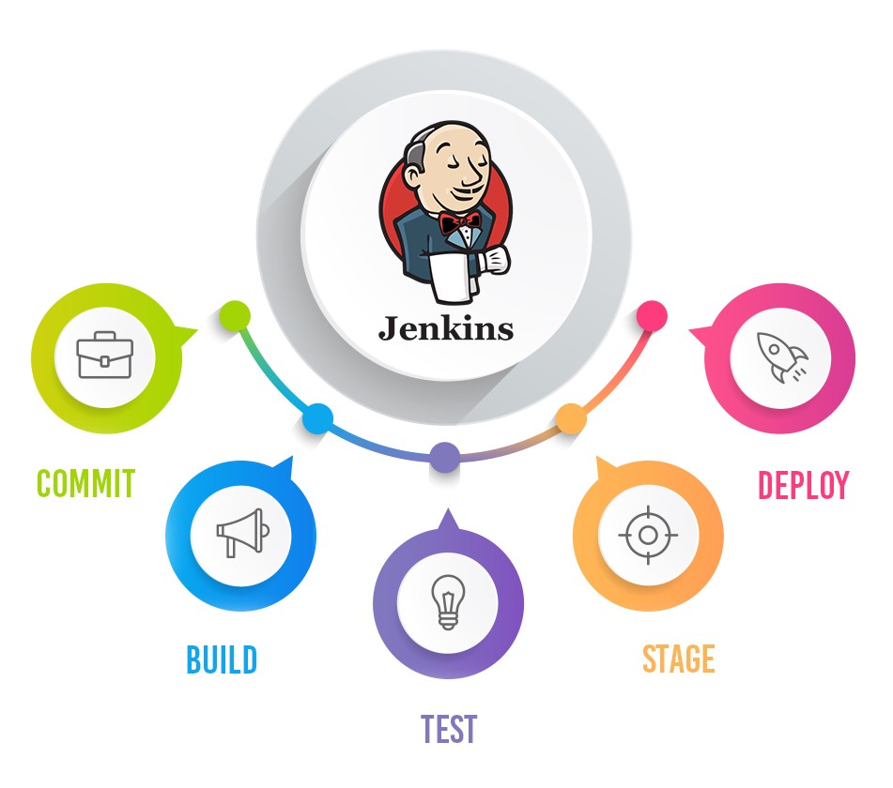
Manage manage and assign roles in jenkins
Pramod Dutta

Slide 2
Agenda
Create User
Assign Role
Manage Access of Jobs

Slide 3
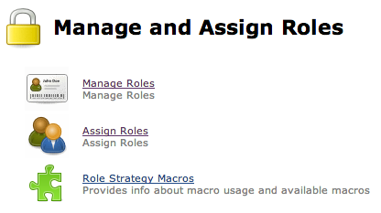
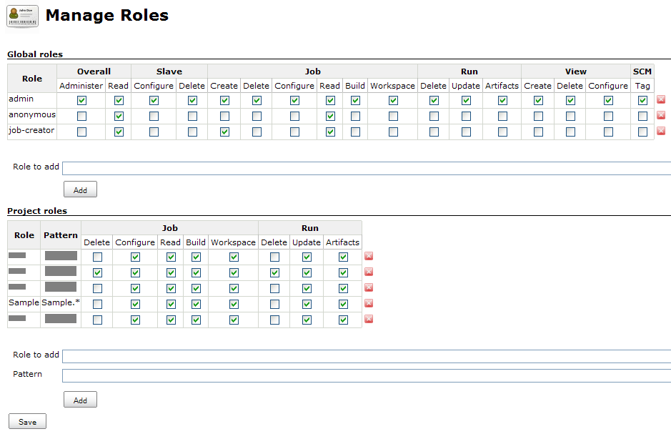
PROBLEM
We don’t want Tester’s to see Dev jobs or vice versa

Slide 4
Solution
Using the Access Matrix - Role Strategy PLUGIN

Slide 5
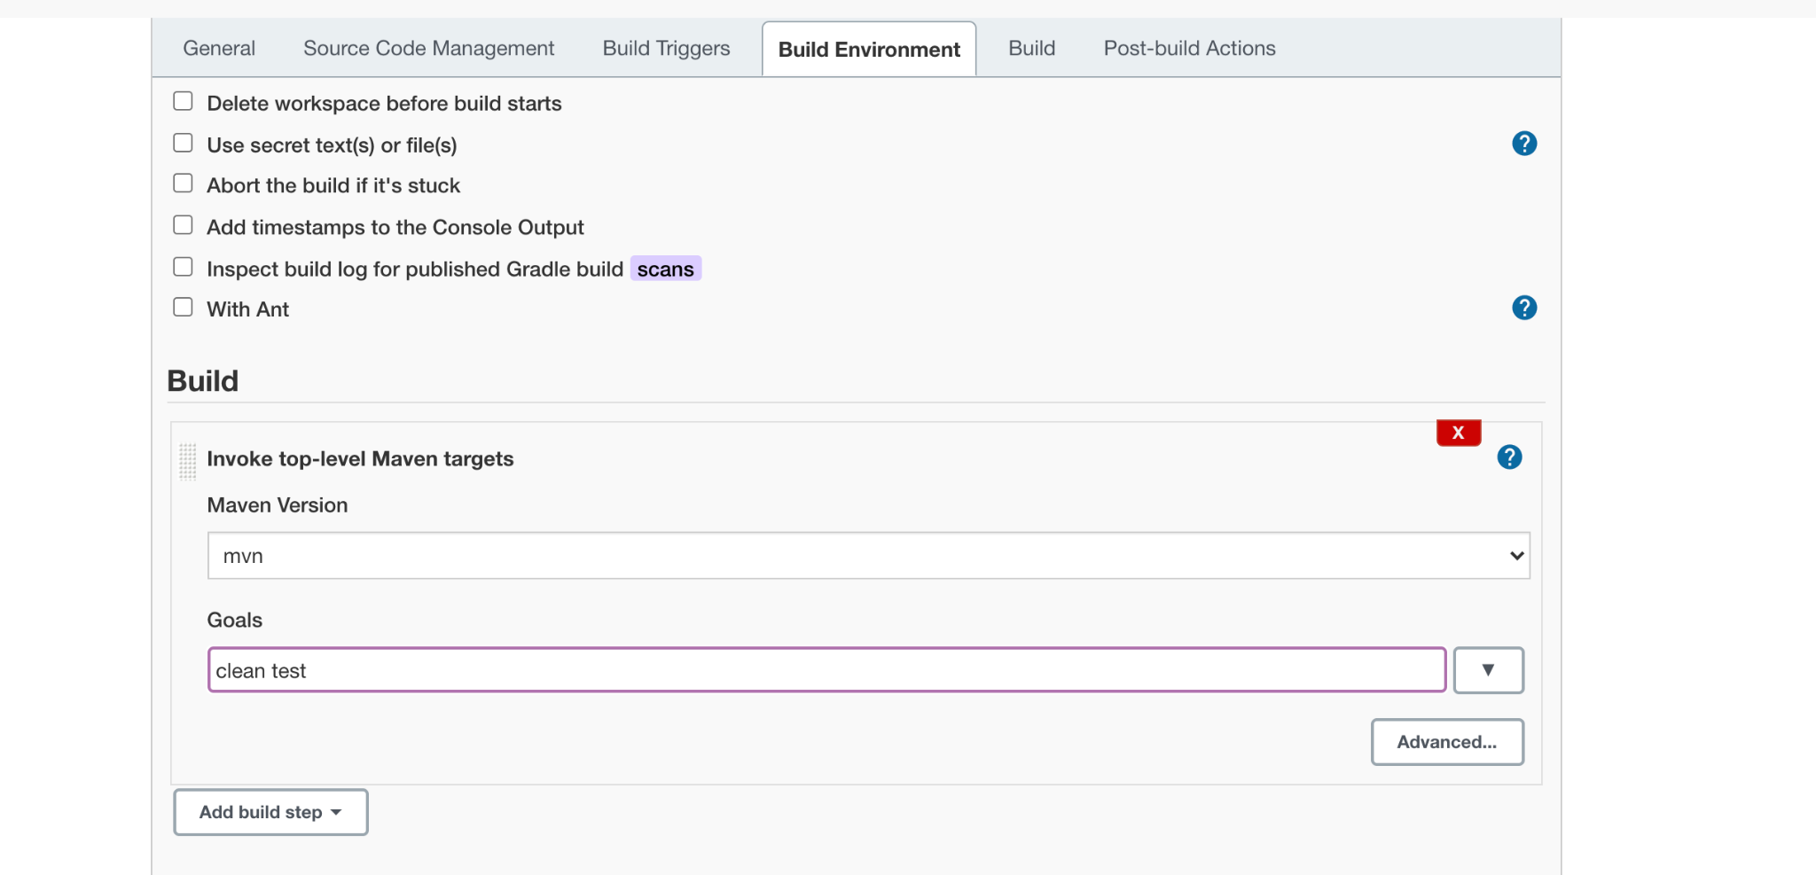
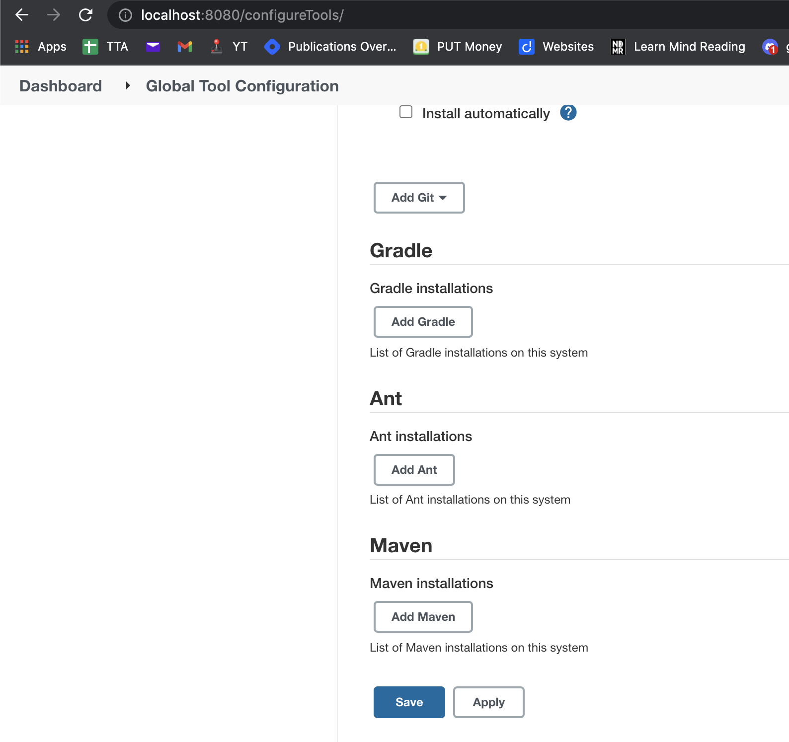
Solution
We are running Maven project but we get
Maven command not found

Slide 6
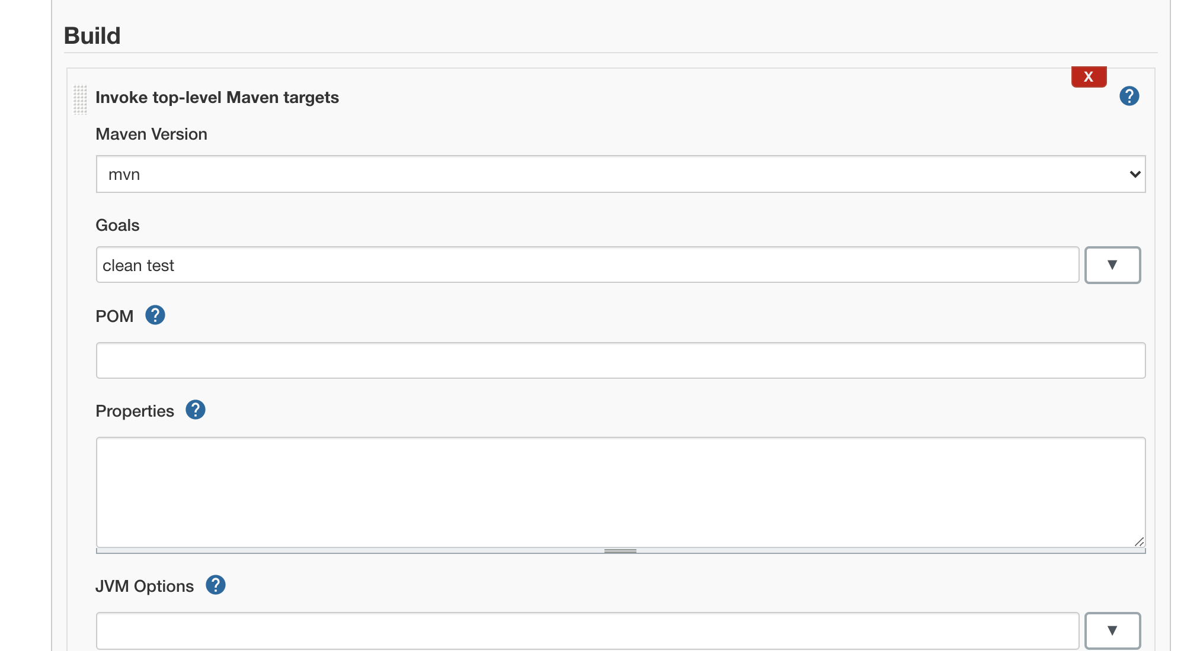
Solution
We are running Maven project but we get
Maven command not found

Slide 7

Lets See Jenkins Job Demo
Demo Jenkins job

